Slide 1




PAY PRO DYNAMICS
Employee Payroll Management System
Smarter Payroll. Simpler Management.

Slide 2

01
OVERVIEW
Pay Pro Dynamics is an employee payroll system built with PHP and MySQL on XAMPP. It keeps employee records, attendance, deductions, and payroll in one place, so every payslip traces back to real data. This presentation covers the design, the main modules, and how payroll is computed and protected.

Slide 3

02
BACKGROUND
The idea came from a common problem: employee data in one file, attendance in another, and pay computed by hand. That setup makes mistakes hard to find. The system fixes this by linking each employee to their department, position, attendance, deductions, and pay history.

Slide 4

03
ARCHITECTURE
HOW IT IS BUILT
Three parts work together: the pages staff click through, the PHP code that checks and computes on the server, and the MySQL database where everything is stored.
1
2
3
Pages are plain HTML, CSS, and JavaScript. Same sidebar everywhere, with cards, tables, and confirmation messages.
PHP on XAMPP does the real work. It checks logins and roles, hashes passwords, and computes final pay before saving.
MySQL stores eleven linked tables. Keys keep records matched, money uses exact decimals, and a log tracks activity.

Slide 5

04
MODULES
MAIN MODULES
These are the parts staff use every day. Each one searches, filters, checks entries, and saves to the database.
1
2
3
Employees, departments, and positions. Add and edit staff, group them right, and view full profiles with history.
Attendance and payroll. Time in and out fill hours on their own, then each run moves from draft to processed to paid.
Deductions, reports, users, and settings. SSS, PhilHealth, Pag-IBIG, tax and loans, six reports, roles, and company setup.

Slide 6
05
FEATURES
1.
Dashboard that answers questions. Staff totals, this month's payroll, charts, and the newest payments at a glance.
2.
Payroll that locks when done. Drafts can change, processed and paid runs cannot, and reopening is recorded.
3.
Roles that hold up. Admin, manager, and employee see only what they should, checked on the server.
4.
Entries that get checked. Negative pay, duplicate codes, and repeat payroll periods are refused politely.
5.
Payslips ready to print. Earnings and deductions laid out cleanly on an A4 page.
6.
Reports from live data. Filter by date or department, then print or export to CSV.

Slide 7

06
PAYROLL
Attendance feeds the hours, deductions for the period pull in on their own, and the server works out gross and net. Nothing is final until someone reviews and confirms it.
1
Record. Time in and out set the regular, overtime, and late hours for each day.
2
Compute. Overtime is hours times rate, gross adds allowances, net subtracts deductions.
3
Confirm. Review the run, process it, and print the payslip. Paid runs stay locked.

Slide 8
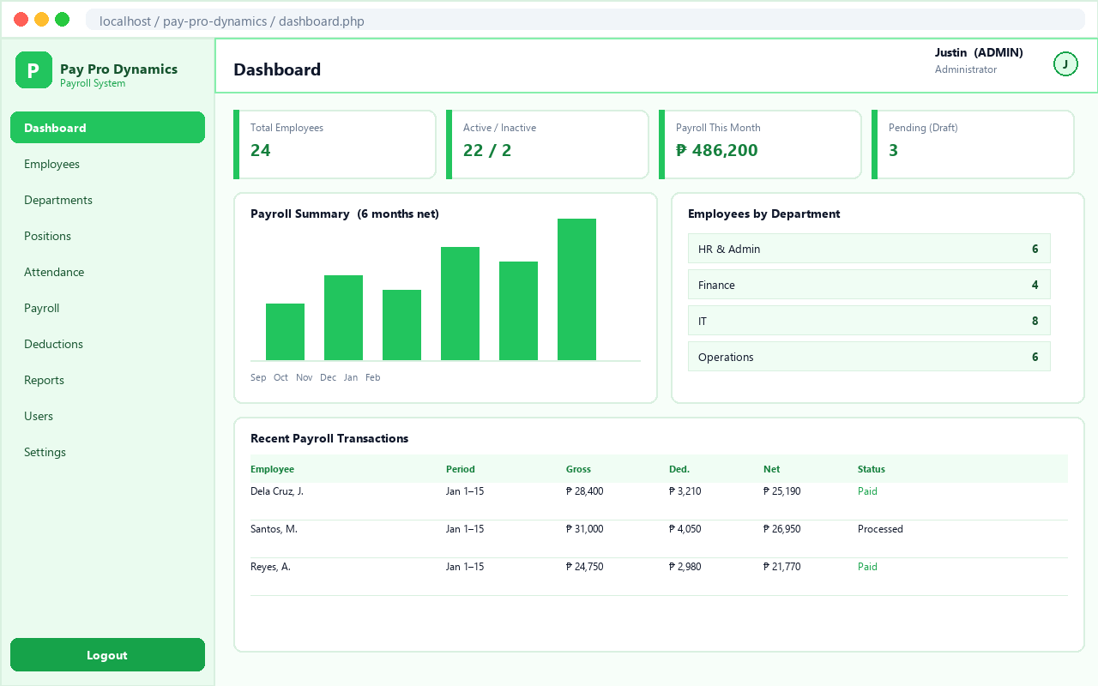
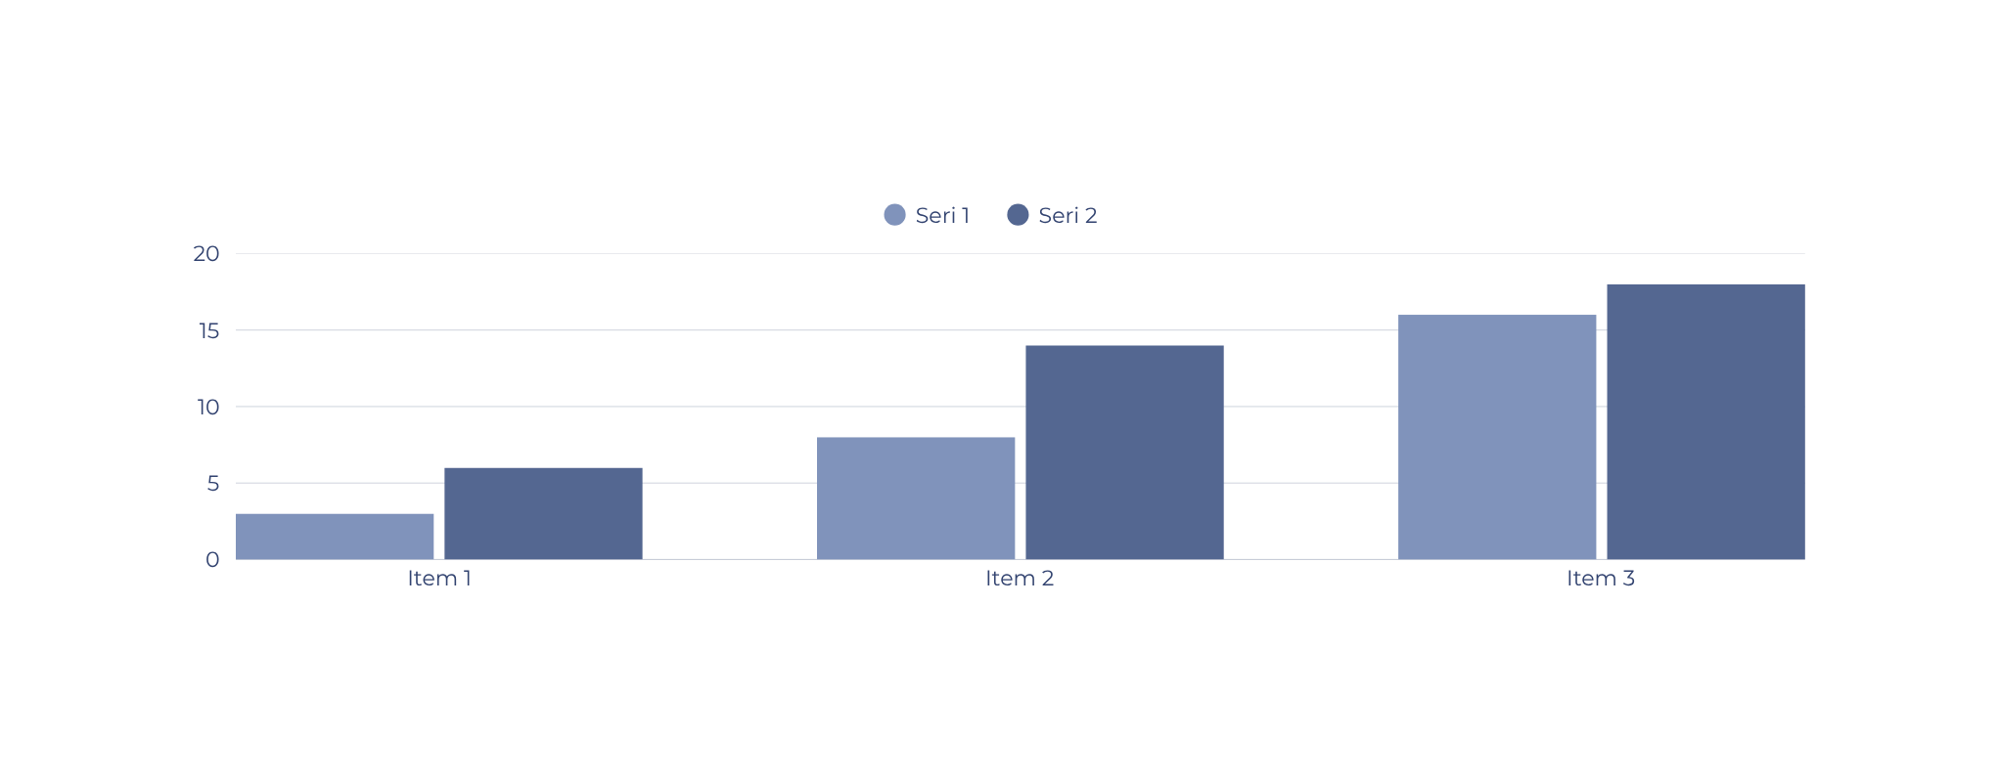
07
LIVE SYSTEM
This is the dashboard staff open each morning. Four totals on top, a six-month payroll chart, the department mix, and the latest payments below.

Slide 9

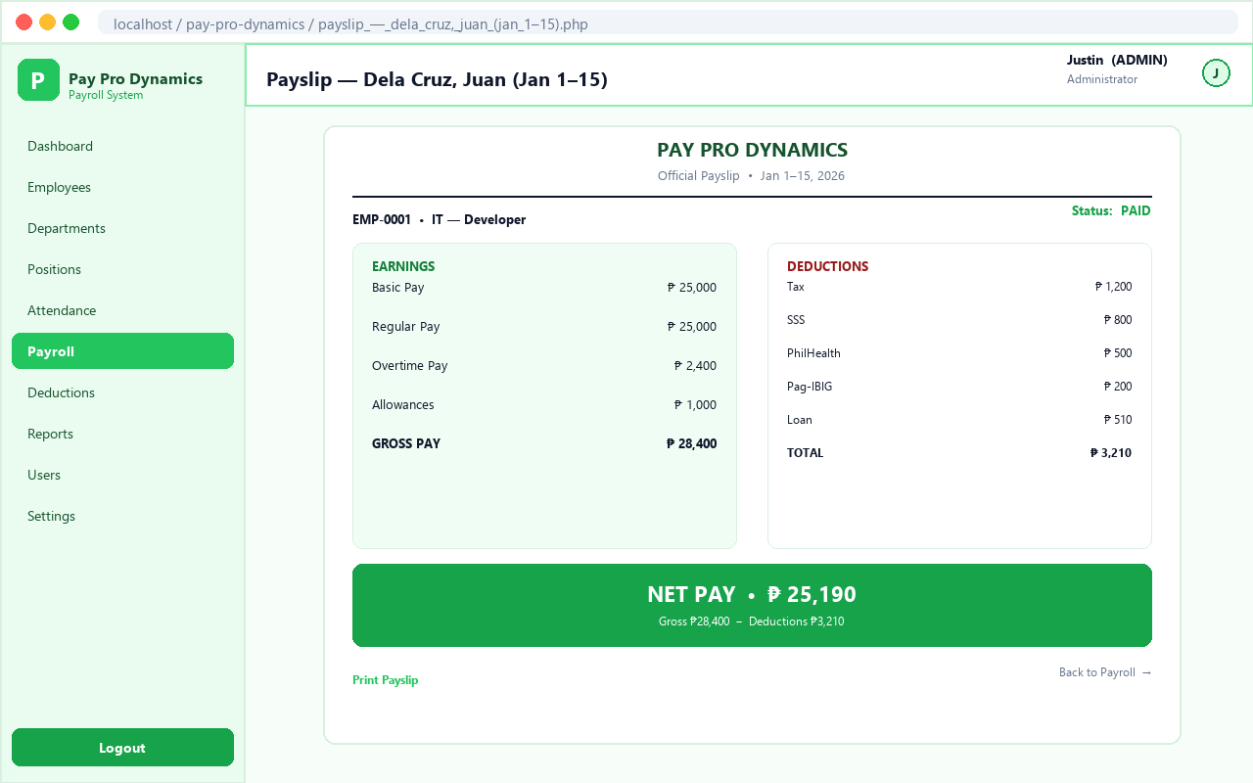
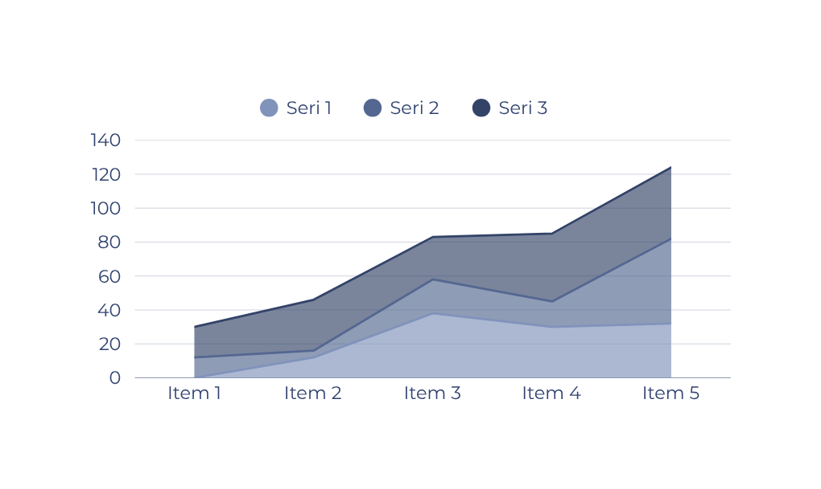
08
SETUP & TESTING
Getting it running takes a few minutes: start XAMPP, copy the folder, import one SQL file, and sign in.
1
Run it. Start Apache and MySQL, import pay_pro_dynamics.sql from phpMyAdmin, then open the login page.
2
Try it. Add an employee, record attendance, create and process payroll, print the payslip, export a report.
3
Sign in. Admin, manager, and employee accounts are included so each role can be tested.

Slide 10
THANK YOU
Live demo next. Questions welcome.

